Slide 1
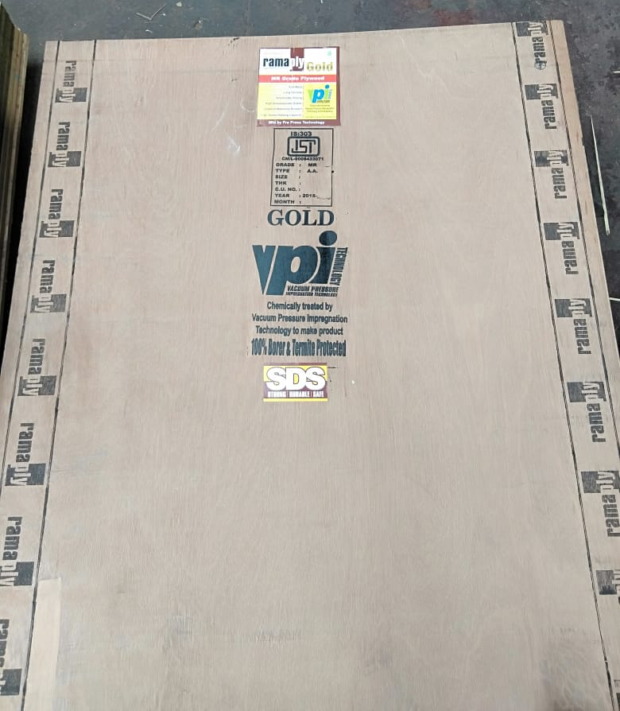
Gold
Notes:
WIDTH OF

Slide 2

Gold 30Kg
Notes:
No domino

Slide 3
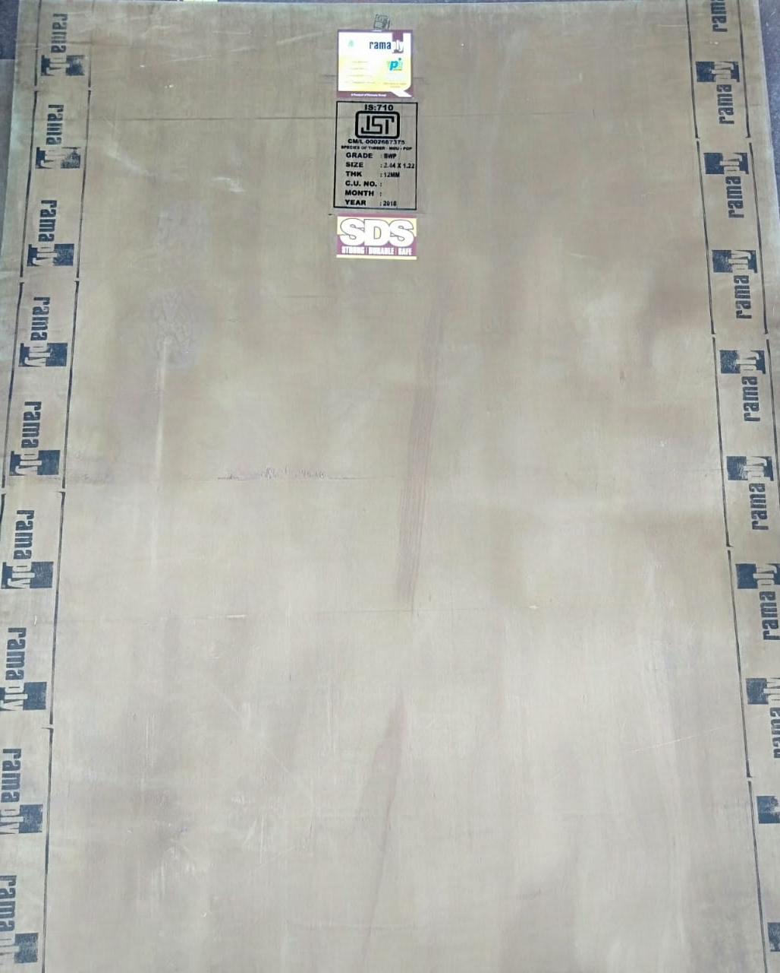

Slide 4
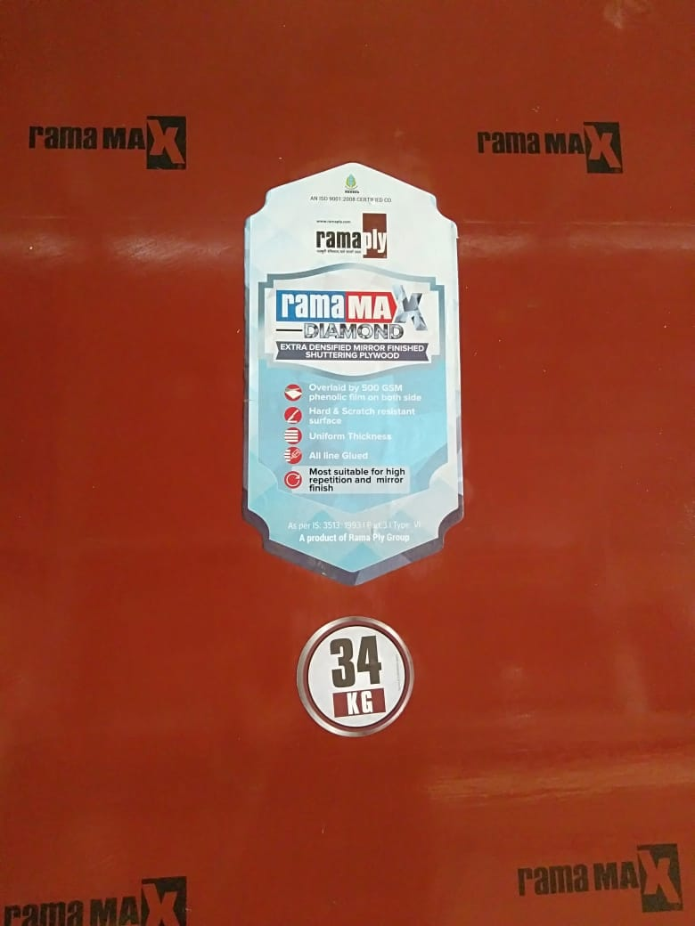
RAMAMAX 34KG

Slide 5
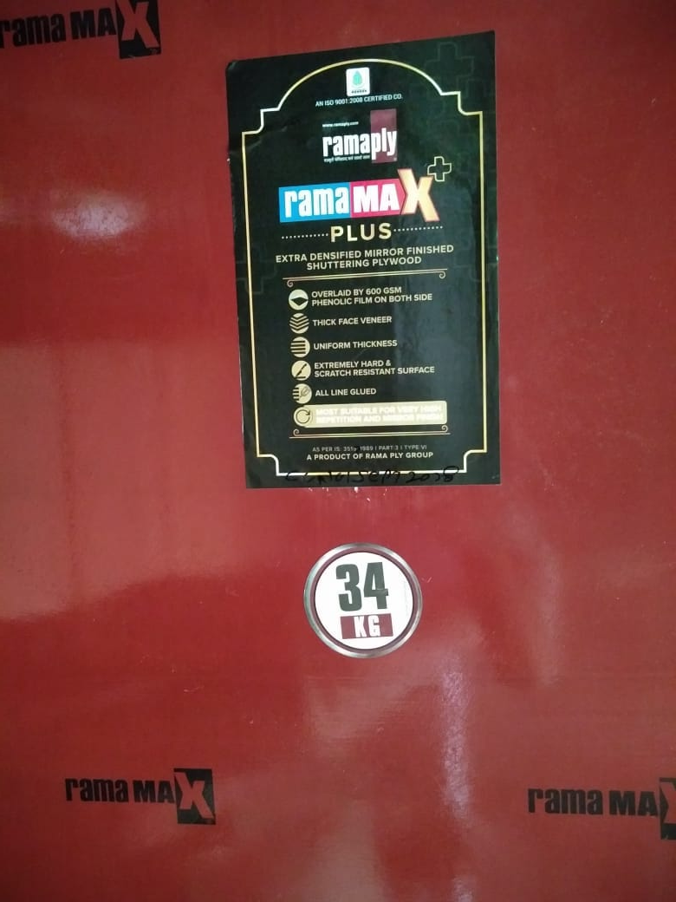
RAMAMAX PLUS 34KG

Slide 6


Slide 7
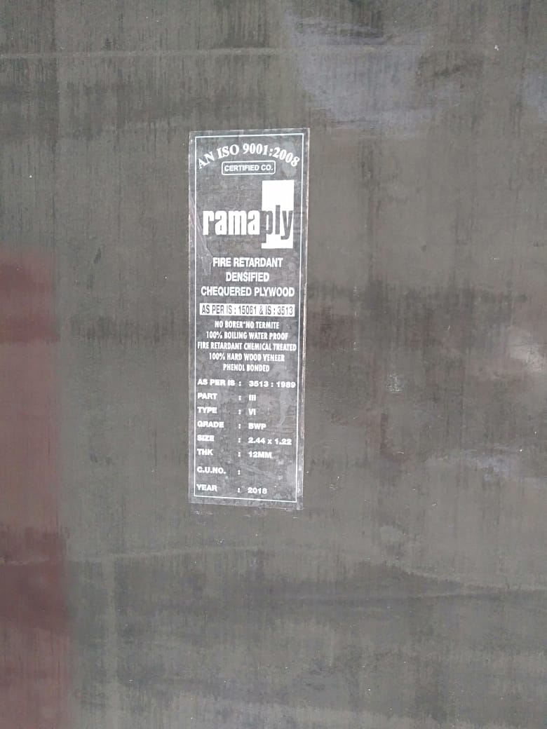

Slide 8
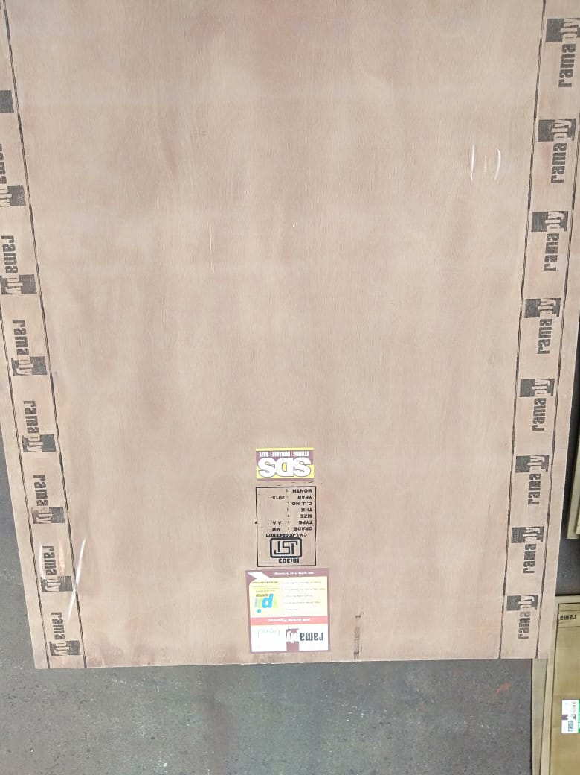

Slide 9
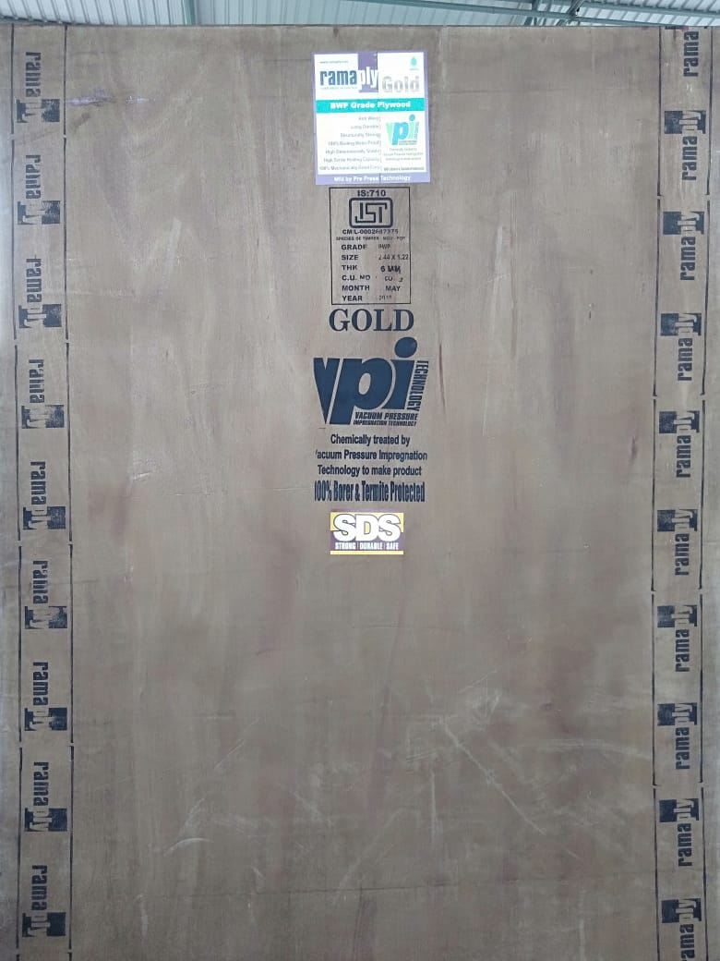

Slide 10
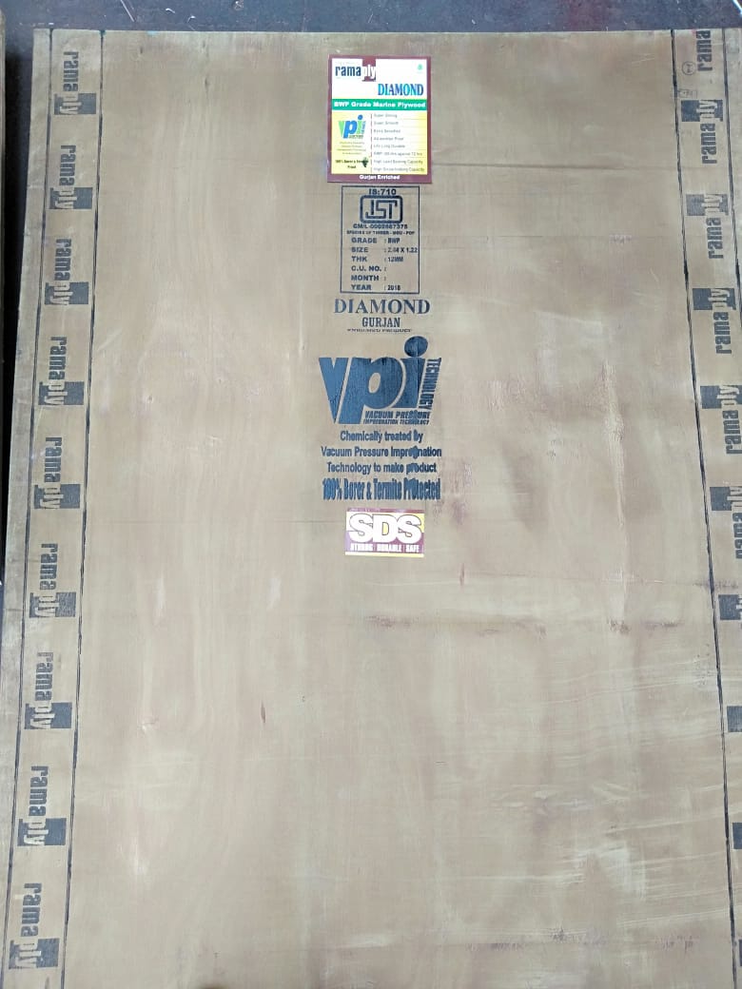
Diamond
Notes:
Gurjan
Width of roller 3inch black colour commercial matter bwp mr door

Slide 11
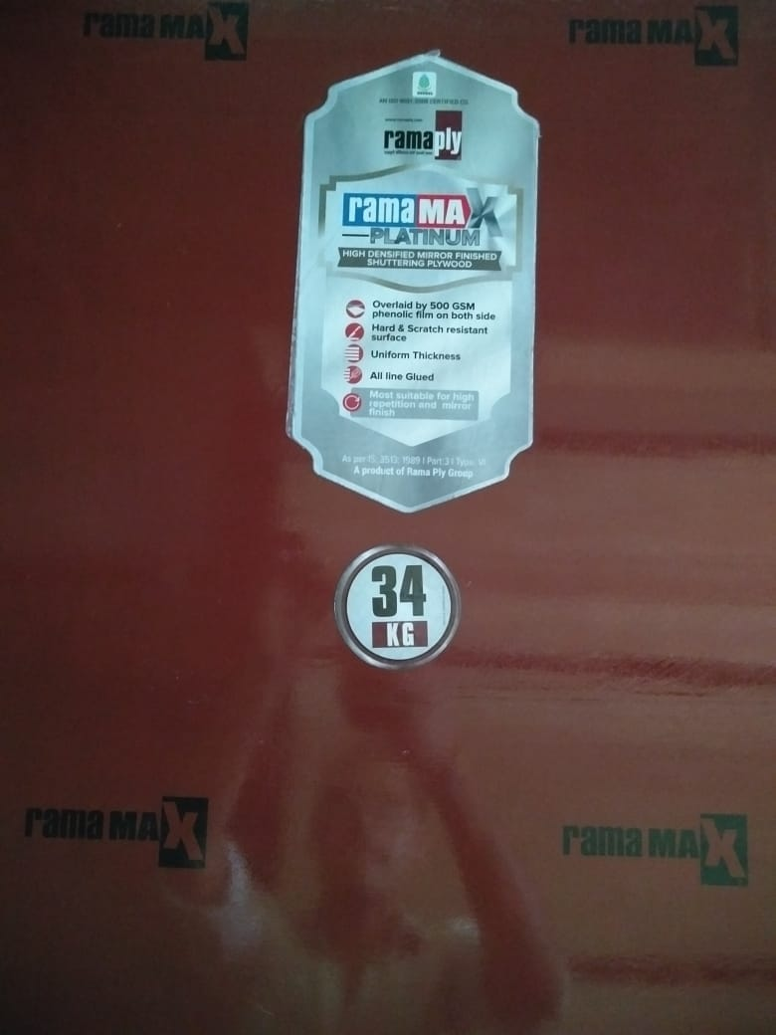

Slide 12
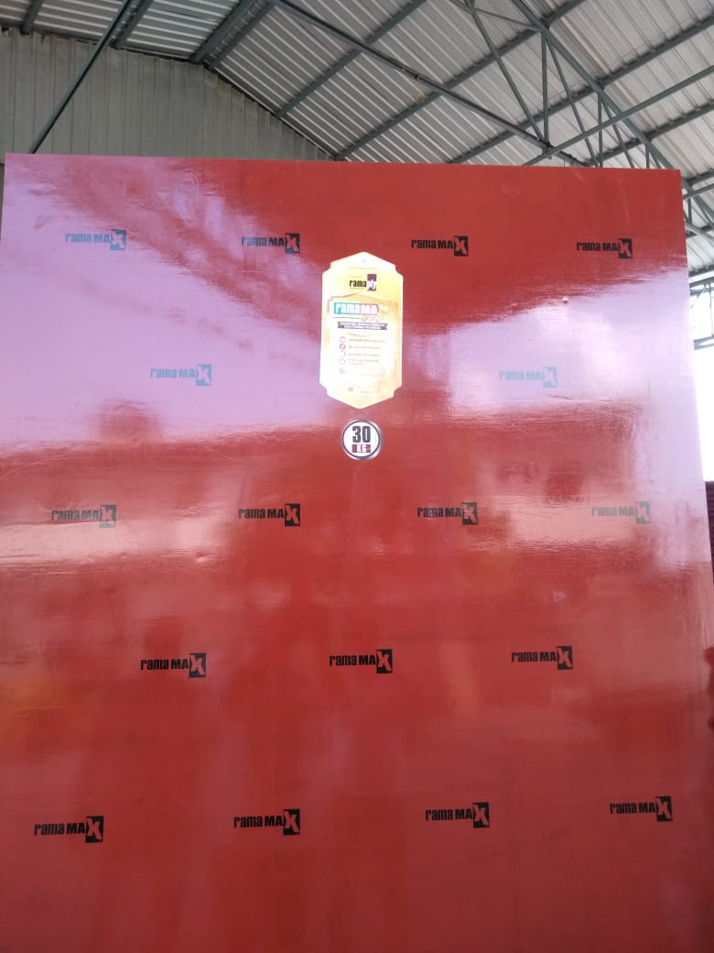
Notes:
Film

Slide 13
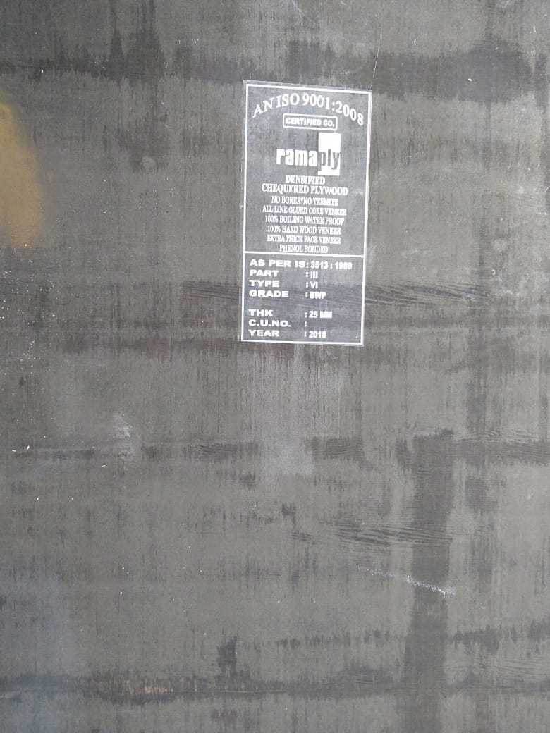
Notes:
Pvc sticker – chequered ply / highly densicfied ply / autmotive plywood

Slide 14
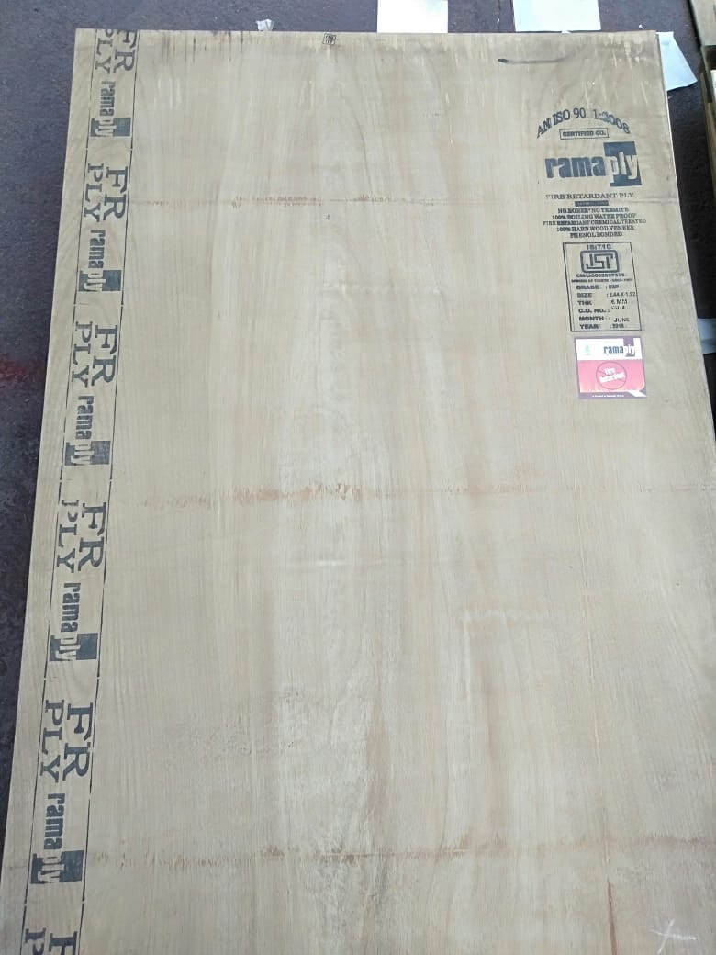
Notes:
Fr ply sperate roller for all automotive products
Width 3inch

